Slide 1

2015
IIHF World Championship
City preparation
Fire Rescue Service
Czech Republic

Slide 2

2015 IIHF World Championship City preparation FRS CZ
Integrated Rescue System of the Czech Republic
Fire Rescue Service of the Czech Republic
HAZMAT Support points FRS CZ
Tactical procedures FRS CZ
Fire Brigade of Prague
City preparation

Slide 3
CZ Integrated Rescue System
IRS CZ is established under the Act No.239/2000
Integrated Rescue System is determined for coordination of rescue operations in case, where a situation requires operation of forces and means of several bodies
Basic IRS bodies:
  Fire Rescue Service of CZ and other fire units
  Police of the Czech Republic
  Medical Rescue Service

Slide 4
CZ Integrated Rescue System
Other IRS bodies:
Specified forces and means of Czech army
Other armed security services
Other rescue services
Public health protection authorities
Emergency, stand-by, specialized and other services
Civil Protection establishments
NGOs and civil associations, which can be used for rescue operations

Slide 6
Fire Rescue Service of the Czech Republic
Mission and Tasks FRS CZ:
State Fire Supervision
  Activities in the field of fire prevention
Civil Protection
  Area of the emergency survival, evacuation and sheltering
Crisis Management
  Emergency and Contingency Planning
Fire Rescue Units
  Professional and voluntary

Slide 7
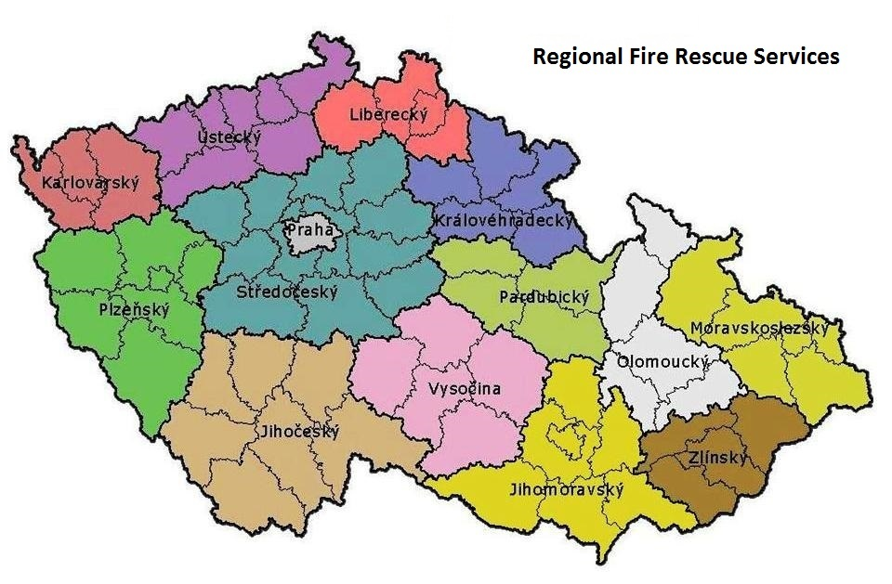
Fire Rescue Service of the Czech Republic

Slide 8
Incident Command System FRS CZ
Levels of the Incident Command System:
Tactical
  Coordination by Incident Commander
  Divided to sections and sectors
Operational
  Coordination by Emergency Call Centre
Strategical
  Coordination by Regional Government/Ministry of Interior

Slide 9
Incident Command System FRS CZ
Standard Operation Procedures for:
Determination of the incident commander
Priority in Command System
Authorization and tasks of the incident commander

Slide 10
Incident Command System FRS CZ
Standard Operation Procedures:
Methodological sheets – tactical procedures for fire units
  Decision-making process of the Incident commander at the tactical level
Joint standard operating procedures at the common intervention of the Integrated Rescue System
  A mandate and basic priorities for IRS bodies

Slide 11

Tactical procedures FRS CZ

Slide 12
Tactical procedures FRS CZ
The commander's staff:
(crisis management structure of the incident commander)
Communication
Logistics support
Analysis
Monitoring of forces and resources
Other specialists

Slide 13
HAZMAT Support points FRS CZ
For solving CBRN issues, has the FRS CZ rules and selected fire units with special training and equipment - support points
In the Czech Rep. are 12 support points & 5 special laboratories
Tasks:
Liquidation of the dangerous substances
Extended detection of the hazardous substances
Decontamination of the fire fighting equipment and population
Oil accidents

Slide 14
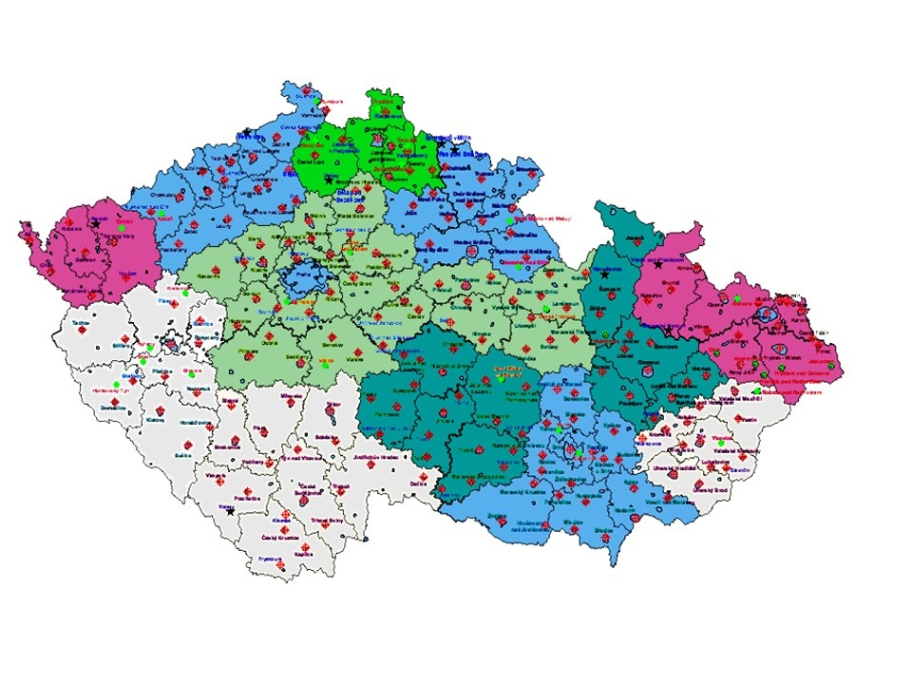
Fire Rescue Service of the Czech Republic

Slide 15

Fire Brigade of Prague
It is a part of Fire Rescue Service of the Czech Republic
It is an independent government organization
It has competence at the territory of the Prague City

Slide 16
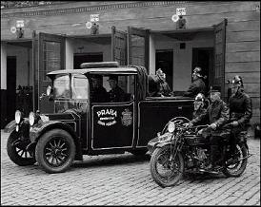
Fire Brigade of Prague
Established in 1853
10 fire stations
901 members and civilian employees
549 firefighters, 183 per shift

Slide 17
Fire Brigade of Prague CBRN Team
The main task is to provide chemical services is to solve accidents with chemical hazards - polluted streams, leakages of flammable, toxic, corrosive or otherwise hazardous liquids, gases and their detection, detecting the presence of radioactive materials and chemical warfare agents
Another part of the intervention team CBRN is a decontamination of fire fighters and equipment from hazardous substances, as well as disinfection of surfaces on suspicion of using these substances.
CBRN team is a member of the crisis management structure of the incident commander

Slide 18
Fire Brigade of Prague CBRN Team
Chemical service has 24 members, three shifts
In each shift are two chemists with university education, 3 technicians with secondary education and two drivers - technicians with secondary education.
Department head, deputy and one technician, all university educated

Slide 19
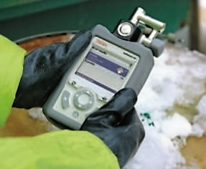
Fire Brigade of Prague CBRN Team
A special equipment for interventions for hazardous substances
  Identify explosives or hazardous materials
  Identify unknown solid and liquid chemicals down range including explosives, toxic industrial chemicals, chemical weapons, narcotics, precursors, white powders and more
  Detect most common hazardous gases including chemical Warfare Agents
  Radiation monitoring

Slide 20
Fire Brigade of Prague City preparation
Rules and measures – structured order of the fire chief
  Planning process, special education
  Actions of the Fire Brigade Prague on the fire prevention field before championship at the sport arena and accommodation facilities
  Communication plan
  Tactical units on the spot
  Liaison officer
  Crisis management staff
  Incident commander

Slide 21
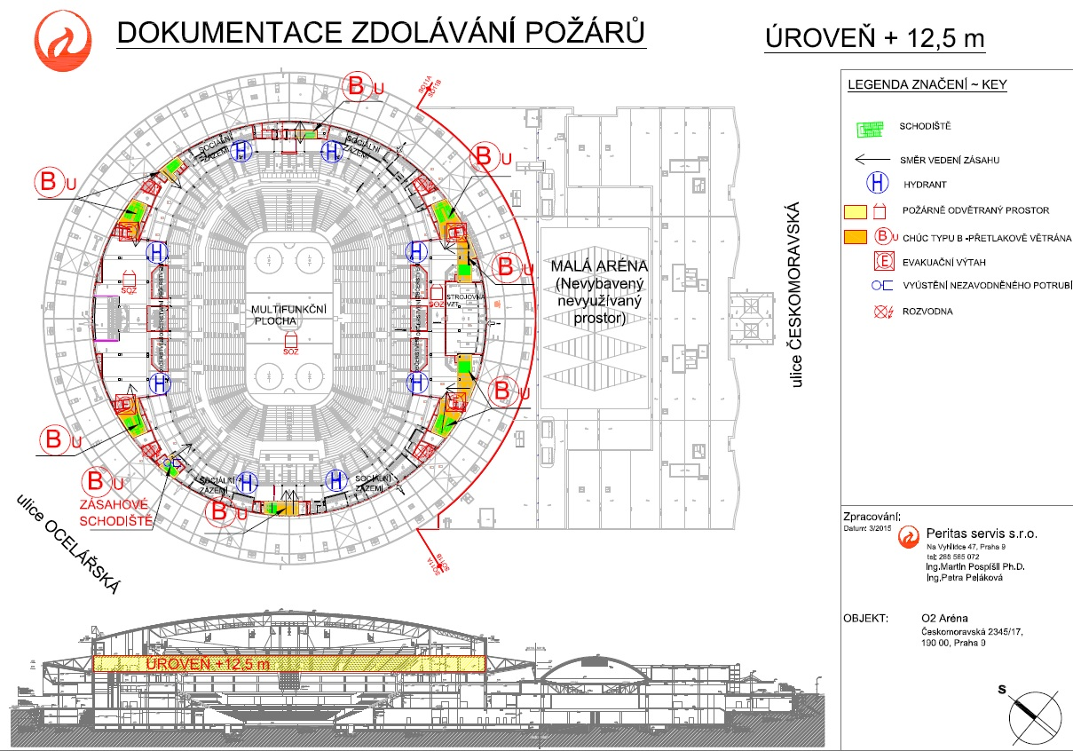
Fire Brigade of Prague City preparation

Slide 22
Fire Brigade of Prague City preparation
Exercise of the basic IRS bodies
  chemical attack, detection, decontamination, evacuation
  Responsibilities and mandate of the IRS
Forces and means allocated for the championship – regional & central level
  Fire and Police units
  Ambulances
  Chemical laboratory for monitoring

Slide 23
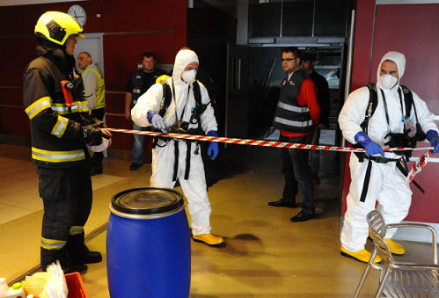
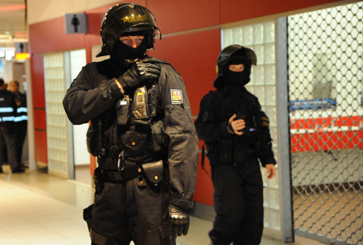
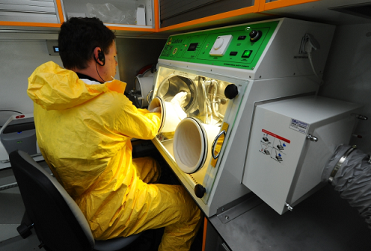
Fire Brigade of Prague City preparation

Slide 24
Thank you for your attention
Roman Hlinovský
Fire Brigade of Prague

